Slide 1
Topic 11: Ppe part 3 – Respirators
[Date of training]
Notes:
Participants log in and get settled.

Slide 2
Agenda
Introductions
Video and Discussion
What is a Respirator?
What is an N95 Respirator?
Reflection
Notes:
Facilitator Notes
Welcome the group and add a greeting to the chat box.
If this session is part of an ongoing series, you may choose to say “welcome back,” “thank you for joining us again,” etc.
Announce housekeeping notes, either orally or via chat.
If needed, provide additional notes specific to the platform you’re using (e.g., how to “raise your hand,” how to post questions).
Provide an overview of the agenda.
Adapt this section of the session as needed: for instance, you may choose to spend additional time on introductions if there are new faces or if participants do not know each other.
Sample Script
“Welcome to Project Firstline. Over the next 20 minutes, we’ll explore respirators, especially one type that’s commonly used in healthcare, the N95. Please keep your videos on, to the extent possible, and keep your microphone muted when you are not contributing to the discussion. It’s great to see you all here today!
“Today we’ll talk about the job of a respirator and about topics that are specific to N95s, including their special role in infection control in healthcare, and how to perform a user seal check.”

Slide 3
Learning Objectives
Describe one (1) job of a respirator.
Describe two (2) aspects of N95s that ensure they protect the wearer from inhaling very small particles.
Explain one (1) way to perform an N95 user seal check and why it is important.
Discuss two (2) possible actions you can take if a leak in the N95 is detected.
Notes:
Facilitator Notes
Provide an overview of the session’s learning objectives.
Sample Script
“Here is what we expect to learn today. By the end of today’s training, you will be able to describe the job of a respirator and important aspects of the N95 respirator – including one way to make sure you have a good seal when you wear one.”

Slide 4
Introductions
Please introduce yourself with:
Your name
Your role (e.g., organization, unit)
Do you regularly wear respirators on the job?
Notes:
Facilitator Notes
This question will give you a better understanding of your participants’ backgrounds, experience, and level of knowledge.
If you know that your audience is unlikely to be familiar with respirators, you may wish to preface the question with the assurance that it’s okay to answer, “I don’t know.”
Tailor your slide delivery for the virtual format and platform, and the number of participants:
You may wish to call on participants individually.
You may wish to add role- or facility-specific questions to the introductions.
If you have a large group, you may decide to skip oral introductions and use the chat.
If your group meets regularly, you may wish to skip or shorten the introductions, or use a different “icebreaker” approach.
Be sure to introduce yourself and anyone who is assisting you.
Sample Script
“Let’s take a minute to get to know each other. Please share in 30 seconds or less your name, your role, and the answer to this question: Do you regularly wear respirators on the job?”

Slide 5
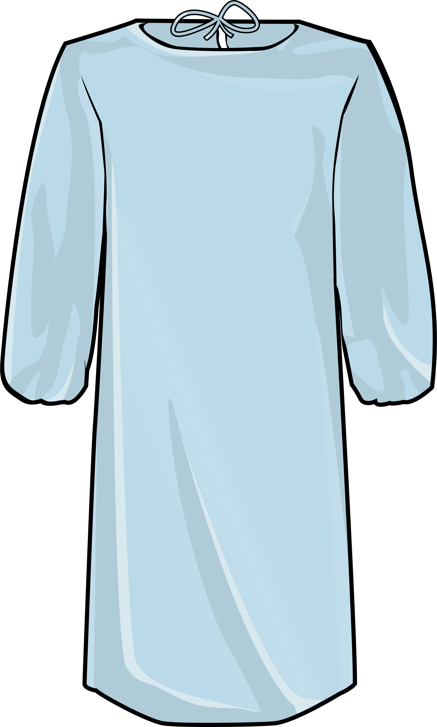
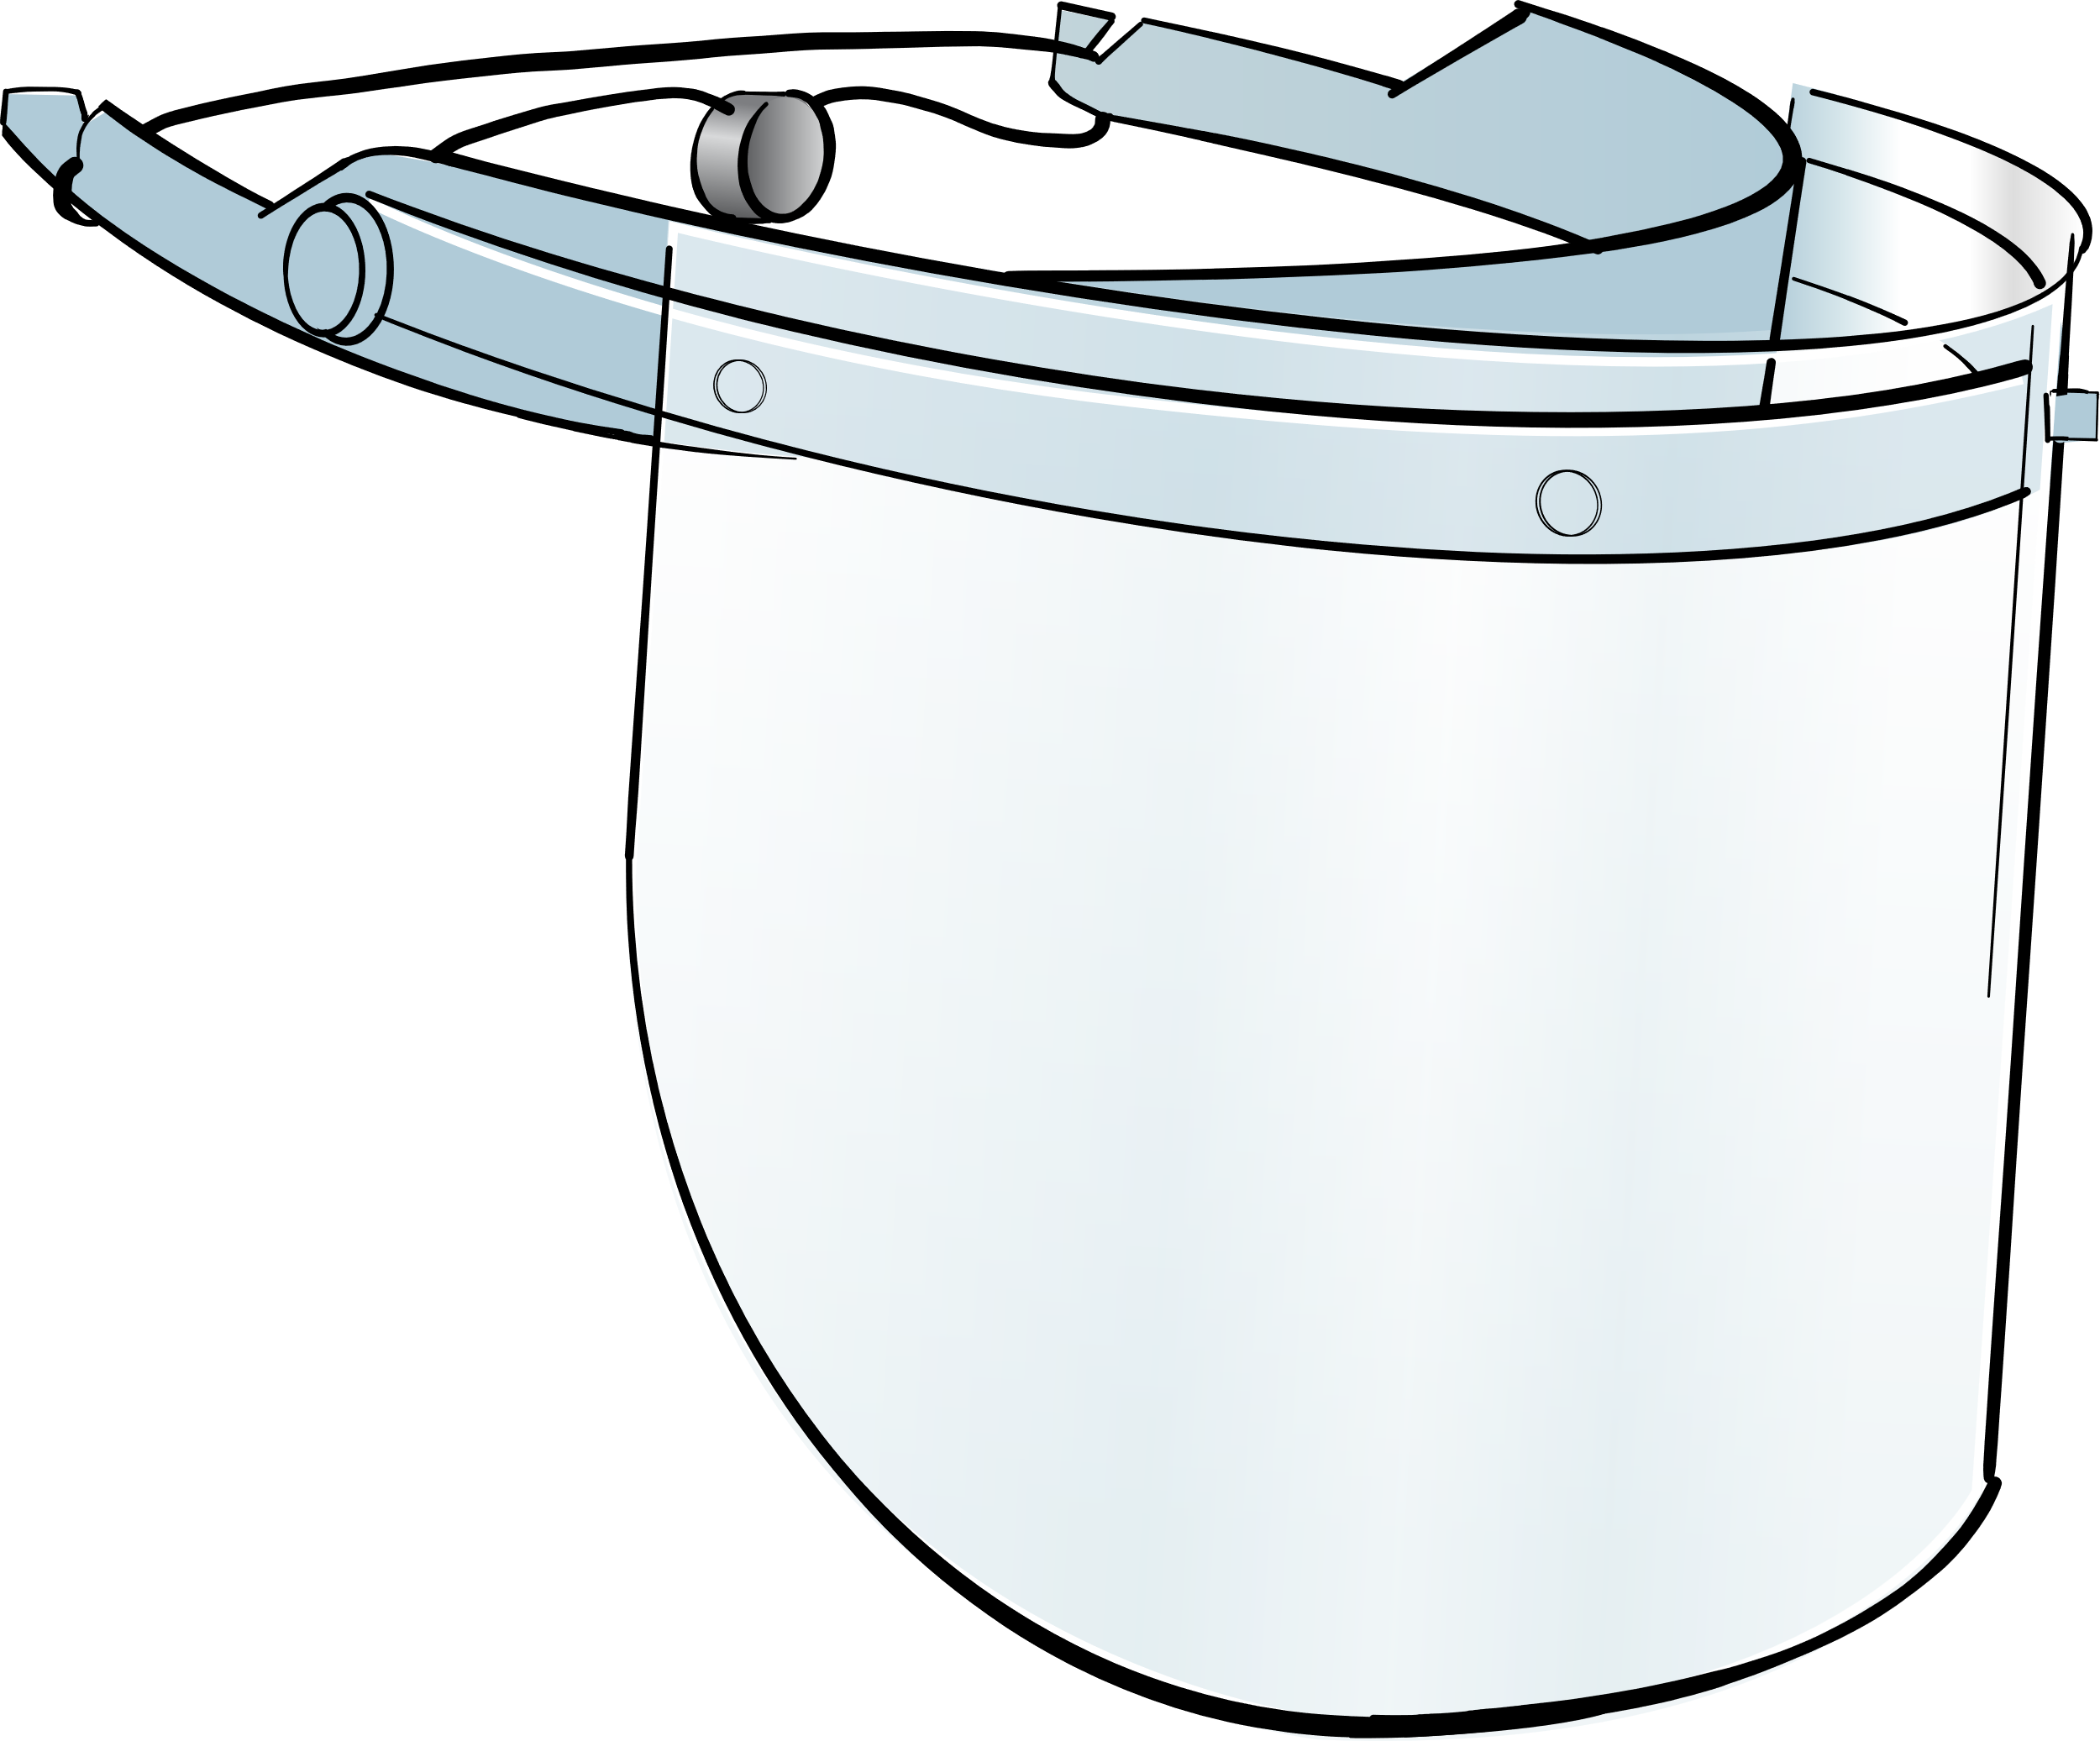
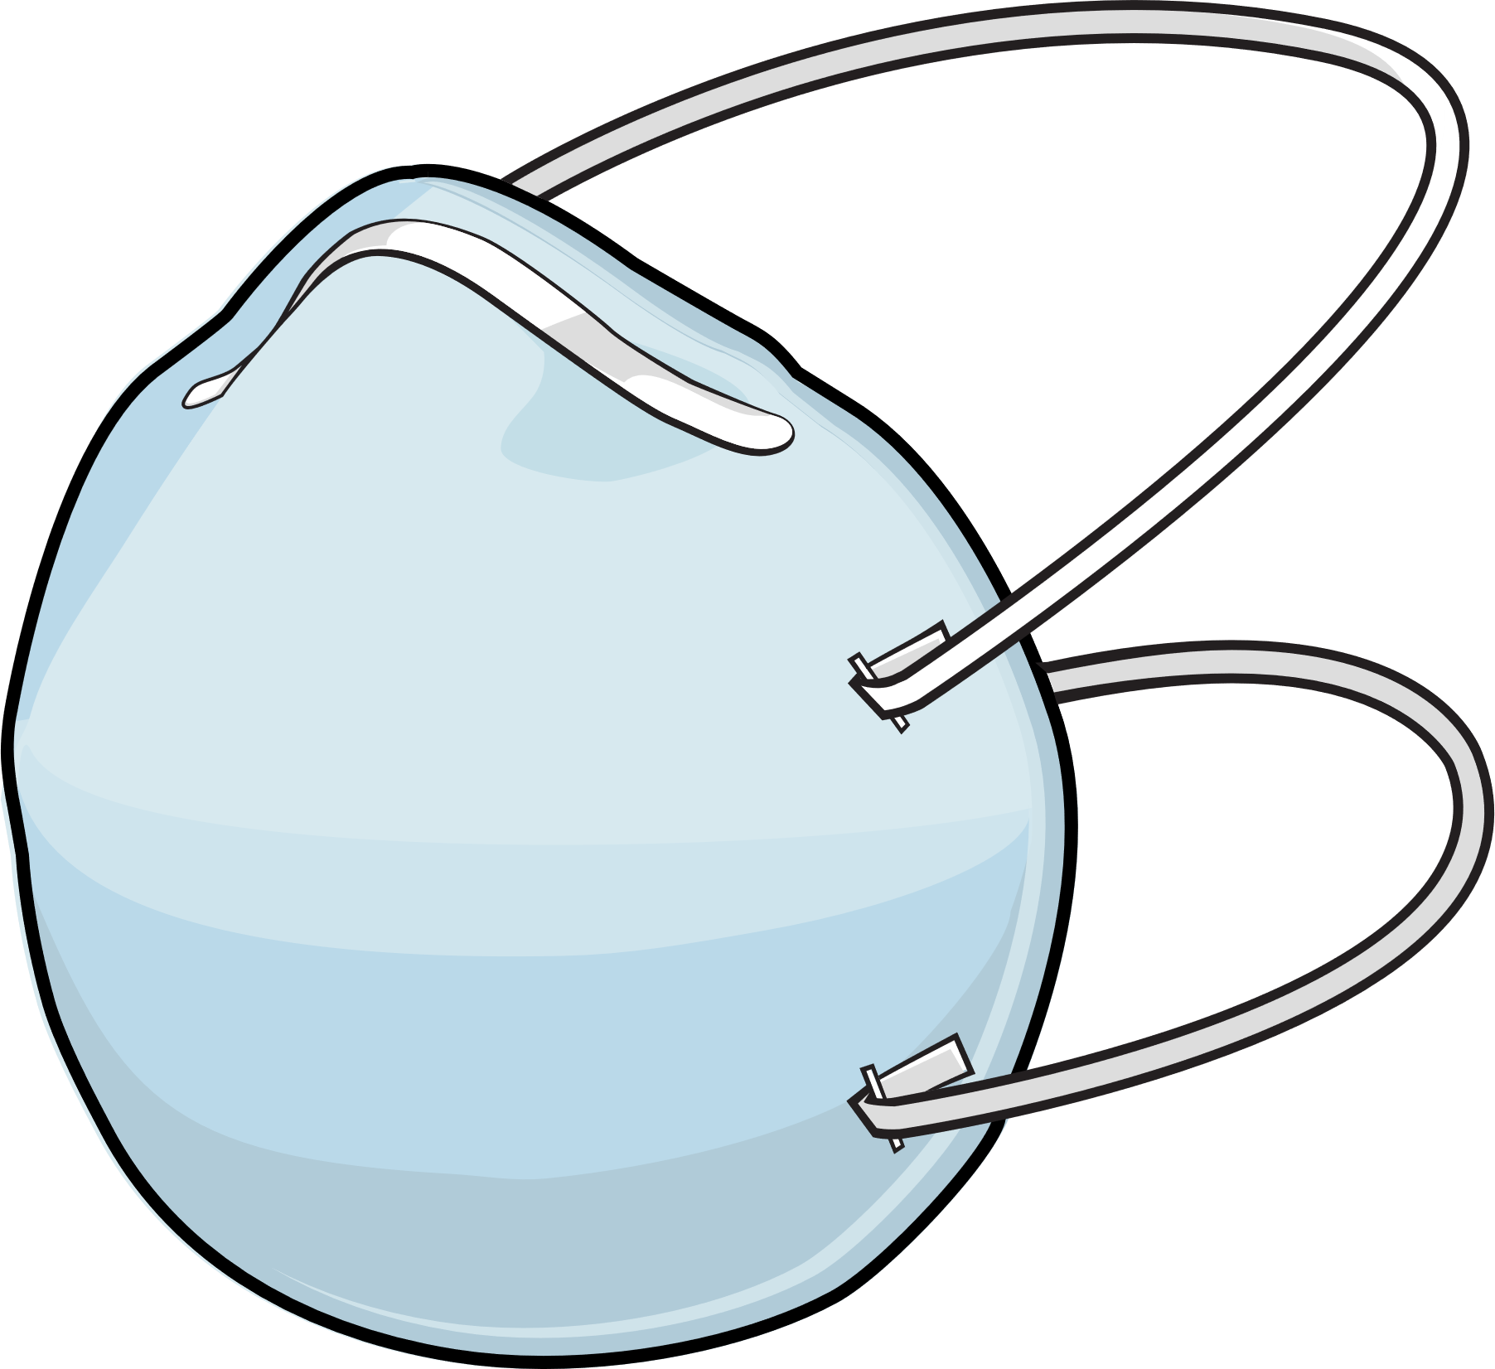
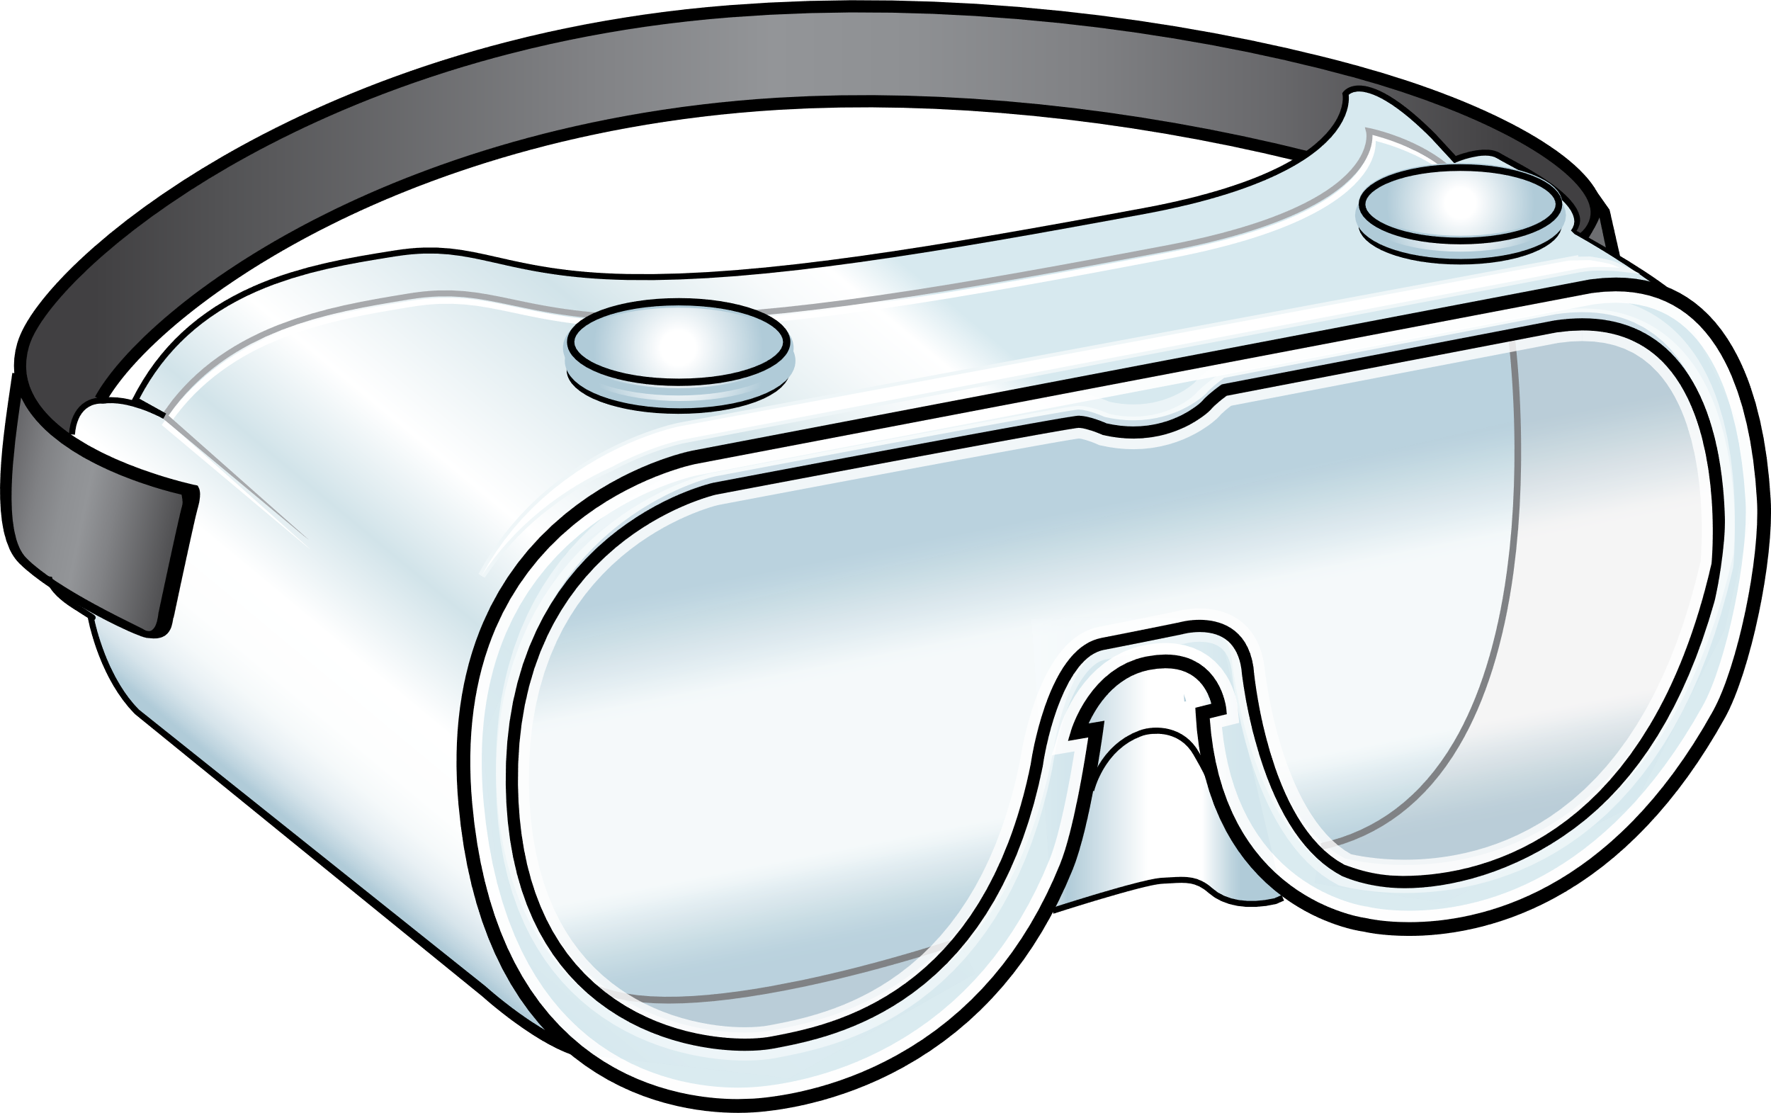
Recommended PPE for COVID-19
Eye Protection
Gloves & Gown
Respirator
Notes:
Facilitator Notes
Transition to discussion about respirators and other PPE recommended for COVID-19.
If this session is part of a series, you may choose to indicate that future sessions will focus on other pieces of PPE.
Sample Script
“Respirators are part of the recommended PPE for COVID-19. In other sessions, we’ll examine other types of PPE.”

Slide 6
Respirators
While watching the video, jot down:
A simple definition of a respirator
Three types of respirators commonly used in healthcare
Notes:
Facilitator Notes
Introduce the video and explain that we will watch it to make sure everyone is on the same page.
Invite participants to make notes as they watch:
A simple definition of a respirator
Three types of respirators commonly used in healthcare
Sample Script
“Let’s start with the basics. We’ll check in with the CDC’s Dr. Abby Carlson to make sure we’re all on the same page as we answer the question, what is a respirator anyway? As you watch, please make note of a simple definition of a respirator and three types of respirators commonly used in healthcare. Please jot down your thoughts in your Participant Booklet.”

Slide 7
Inside Infection Control: What is a Respirator? Episode 13
Notes:
Facilitator Notes
Access the video here:
CDC Website: https://www.cdc.gov/infectioncontrol/projectfirstline/videos/EP13-Respirator-LowRes.mp4
OR
Project Firstline YouTube Playlist: https://www.youtube.com/watch?v=Cwf9tM8Tguk&list=PLvrp9iOILTQZQGtDnSDGViKDdRtIc13VX&index=14

Slide 8
What did you learn about respirators?
Notes:
Facilitator Notes
Invite participants to review the notes they wrote down during the video and share, either orally or in the chat, a simple definition of a respirator and three types of respirators commonly used in healthcare.
Acknowledge responses. Answers may include:
A respirator’s job is to keep you from breathing in things in the air that might hurt you, like germs, dust, chemicals, and other dangerous things.
In healthcare, we use respirators when we think we’re going to be in a situation when we could breathe in air that’s carrying infectious material – like particles containing viruses.
Types of respirators used in healthcare:
Filtering facepiece respirator (FFR), the type most commonly used in healthcare
Powered air-purifying respirator (PAPR)
Elastomeric respirator
You may wish to refer to the Content Outline for Episode 13 of Inside Infection Control for additional discussion points.
Sample Script
“Take a moment to review the notes you took during the video. How would you define a respirator? What are some respirators that are used in healthcare?”
(Pause for responses.)
“That’s great, thank you!”

Slide 9
What is an n95 Respirator?
“N95” is a term used for certain respirators tested and approved for use in healthcare by the National Institute for Occupational Safety and Health (NIOSH).
N95s are designed to filter out certain sizes of very small particles in the air, including droplets, before the air reaches your mouth, nose, and lungs.
Most N95s are also good at blocking your respiratory droplets from spreading to others, including any germs that you are breathing out.
How?
N95s are made of a special filtering material that filters out at least 95% of very small particles in the air.
N95s fit snugly and ensure the air you’re breathing in goes through the filter first and doesn’t leak in around the edges.
Notes:
Facilitator Notes:
Invite group discussion of what an N95 respirator is.
The bullet points on slide 9 summarize content from Episode 14 of Inside Infection Control: What is an N95 Respirator? For time reasons, the video is not shown during the 20-minute session. You may wish to refer to the Content Outline for Episode 14 for additional discussion points.
This slide has animations for the second column. When you advance to the slide, only the first column will appear.
After you introduce the points, ask participants to share answers to the questions “Why?” or “How?” either orally or in the chat.
After they provide responses, use the animation to reveal the answers.
Sample Script:
“Does anyone know what an N95 is?”
(Pause for responses.)
“That’s right. It’s a type of respirator that’s been tested and approved by NIOSH for use in healthcare. Let’s talk about why N95s are important for infection control in healthcare. First, N95s are designed to filter out certain sizes of very small particles in the air. They also block your respiratory droplets from spreading to the environment. How do they do that?”
(Pause for responses.)
“Yes! N95s are made of a special filtering material that filters out at least 95% of very small particles in the air. N95s work not only because of the filtering material but also because of how they fit. They’re put together in a way that makes sure all the air you’re breathing in goes through the filter first and doesn’t leak in around the edges. In order to work correctly, your N95 must fit your face well. So, when it comes to N95s, there are two big things to remember about how they protect you: filter and fit.”

Slide 10
N95 User seal check
A “user seal check” makes sure you have a good seal, because it’s possible to put on an N95 using the correct technique and still not have a good seal around all the edges.
Most of the time, the best way to check the seal is with a “positive pressure” check: gently breathe out while blocking the paths where air might escape.
If the pressure doesn’t build up, or there’s a leak, you can mold the metal nose strip to the bridge of your nose, or move the straps on the top and base of your head to get the best fit.
Notes:
Facilitator Notes:
Invite group discussion of user seal checks for N95 respirators. You may wish to demonstrate a user seal check with a prop, or as depicted in Episode 15 of Inside Infection Control: How Do I Test the Seal on my N95?
The bullet points on slide 10 summarize content from Episode 15 of Inside Infection Control. For time reasons, the video is not shown during the 20-minute session. You may wish to refer to the Content Outline for Episode 15 for additional discussion points.
This slide has animations for the second bullet. When you advance to the slide, only the first bullet will appear.
After you introduce the points, ask participants to share answers to the questions “Why?” or “How?” either orally or in the chat.
After they provide responses, use the animation to reveal the answers.
Sample Script:
“Does anyone know why it’s important to do something called a ‘user seal check’ every time you put on your N95?”
(Pause for responses.)
“That’s right. You want to make sure you have a good seal around all the edges when you put on your N95, because it’s possible to put it on using the correct technique and still not have that good seal around all the edges. If there’s a leak or bad seal, then it’s likely you’ll breathe in unfiltered air, which could have germs in it. So, how do you do a user seal check?”
(Pause for responses.)
“It’s important to follow the instructions on how to do a user seal check that came from the manufacturer of your specific type of N95. Most of the time, the best way to check the seal is with a ‘positive pressure’ check: gently breathe out while blocking the paths where air might escape to make sure there aren’t any leaks around your face or in the filter itself.
“If the pressure doesn’t build up, or there is a leak, use both hands to mold the metal nose strip to the bridge of your nose, starting from the top. You can also move the straps to different areas at the top and base of your head to get the best possible fit.
“If there’s still a leak, you may need to be fit-tested with a different model of N95 or a different size. It’s also possible the N95 may be worn out and you need a new one, or you may need a different type of respirator.”

Slide 11
Reflection
Notes:
Facilitator Notes
Thank participants for the discussion.
If this session is part of a series, you may wish to remind the group of key points from other sessions.
Invite participants to reflect on what they learned during the session.
Sample Script
“You all did a great job! Remember, if you’re ever unsure about what to do, such as how to do a user seal check, you can always talk with your supervisor or your colleagues.
“Let’s use our last few minutes together to reflect on what we’ve learned and think about how we can put what we’ve learned into practice.”

Slide 12
Questions?
Notes:
Facilitator Notes
Invite additional, remaining questions.
You may choose to ask participants to respond orally, in the chat, or both.
If the answers are information that is already included in this session, please respond.
If the questions address content that is not covered in this session, please do not attempt to answer. Instead, take note of the questions and consult with CDC resources to follow up with answers after the session.
Sample Script
“Before we move on, I just want to open it up in case there are any unanswered questions or items I can clarify about respirators and N95s.”
(Pause for responses.)
“Thank you for sharing those questions. I’ve written them down, and I will get back to you with responses.”

Slide 13
Key takeaways
The job of a respirator is to keep you from breathing in things in the air that might hurt you, including germs.
N95s, a type of respirator, are designed to filter out very small particles, including droplets, in the air.
N95s work not only because of the filtering material but also because of how they fit, which ensures that all the air that you breathe in goes through the filter first and doesn’t leak in around the edges.
Do a “user seal check” every time you use your N95, because it is possible to put on an N95 using the correct technique and still not have a good seal around all the edges.
Notes:
Facilitator Notes
Review key takeaways.
You may choose to revisit discussion points or questions that arose during the session.
Sample Script
“I hope this training gave you some good information about respirators and N95s, and why they are so important for infection control. I’ve captured some key takeaways here, which you can review at your leisure after the session today.”

Slide 14
Resources and Future Training sessions
Project Firstline on CDC:
https://www.cdc.gov/infection control/projectfirstline/index.html
Project Firstline on Facebook:
https://www.facebook.com/CDCProjectFirstline/
Twitter:
https://twitter.com/CDC_Firstline
YouTube:
https://www.youtube.com/playlist?list=PLvrp9iOILTQZQGtDnSDGViKDdRtIc13VX
To sign up for Project Firstline e-mails, click here: https://www.cdc.gov/infectioncontrol/projectfirstline/index.html
Notes:
Facilitator Notes
Share additional resources from Project Firstline and CDC.
Explain how participants can reach you, by the means of your choosing, and how they can reach Project Firstline.
If this session is part of a series, you may choose to describe the themes of upcoming sessions.
Sample Script
“Even though we covered a lot today, there is still much more to learn. You can keep exploring these topics on your own using the resources on this slide. You can also follow us on social media. I will stay on the line for a few minutes after our session ends and will be happy to discuss any other questions!”
(If this session is part of a series) “Next time, we will cover [insert next training topic].”

Slide 15
Feedback Form
Notes:
Facilitator Notes
Explain how to access the feedback form.
Sample Script
“And, finally, please let us know how you enjoyed today’s session by completing the following feedback form. Thanks again for joining us today.”
After the Session
Send list of participant questions compiled during this session to ProjectFirstline@cdc.gov.

